Slide 1
Dr.G. Vadivu Professor, DSBS

Slide 2

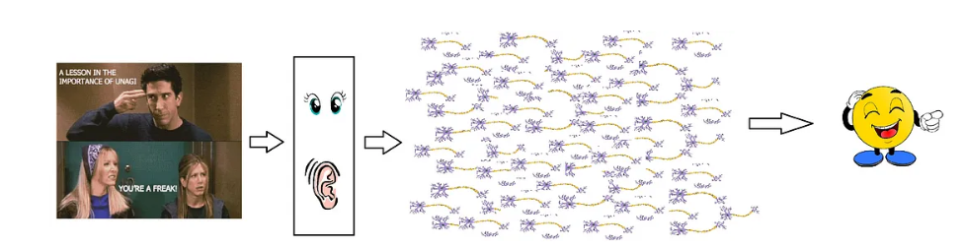

Slide 3
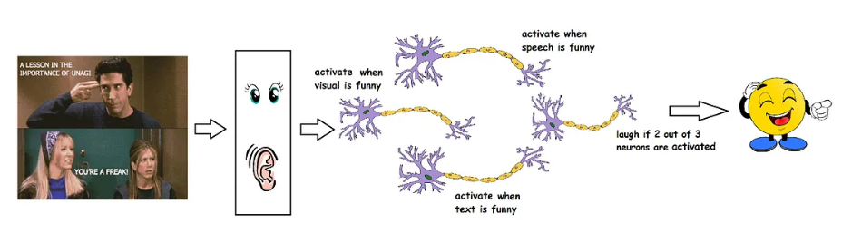

Slide 4
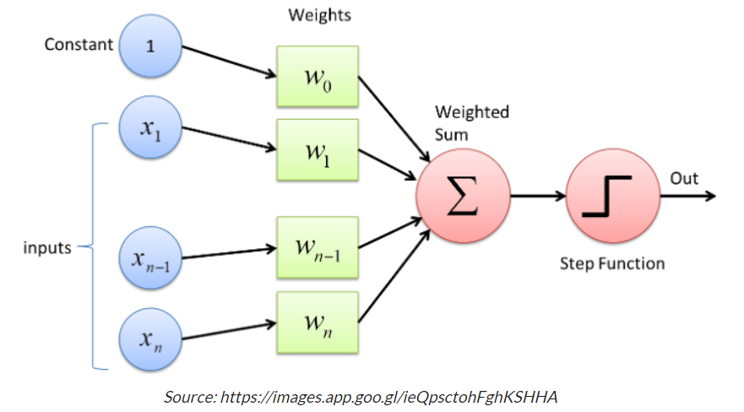
Notes:
https://www.analyticsvidhya.com/blog/2022/10/multi-layer-perceptrons-notations-and-trainable-parameters/

Slide 5
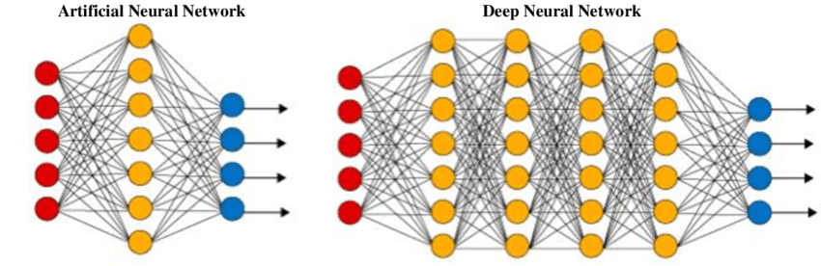

Slide 6
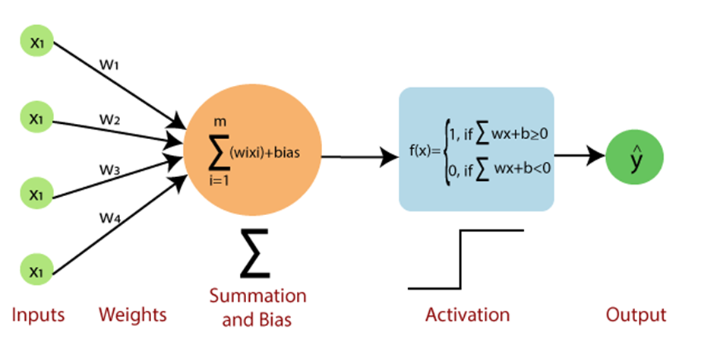
Perceptron

Slide 7
Convolutional Neural Networks

Slide 8
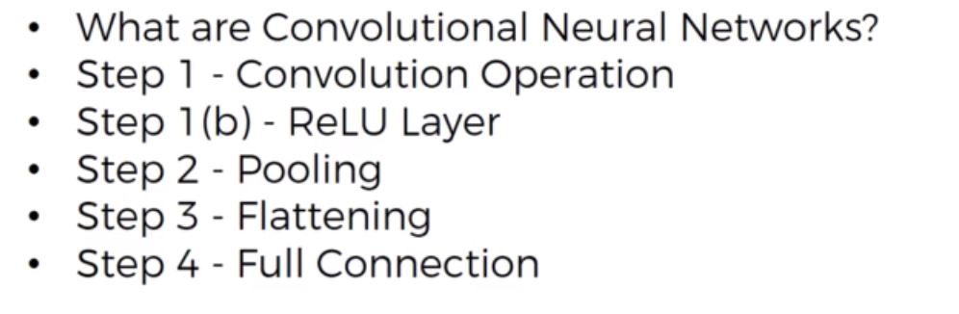

Slide 9
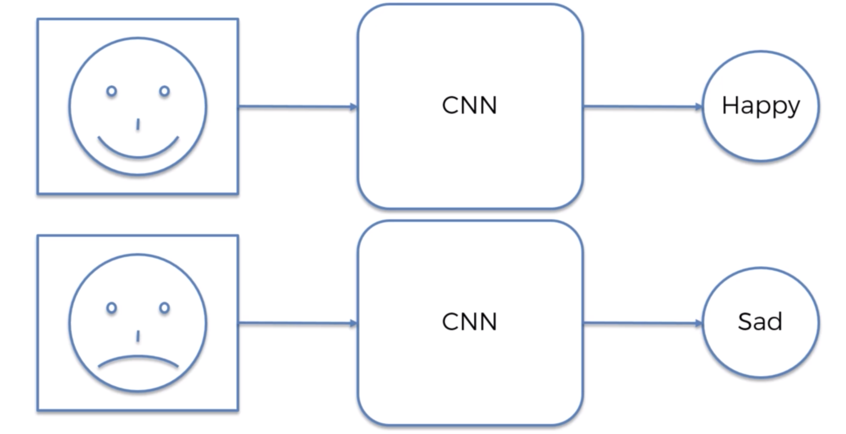

Slide 10
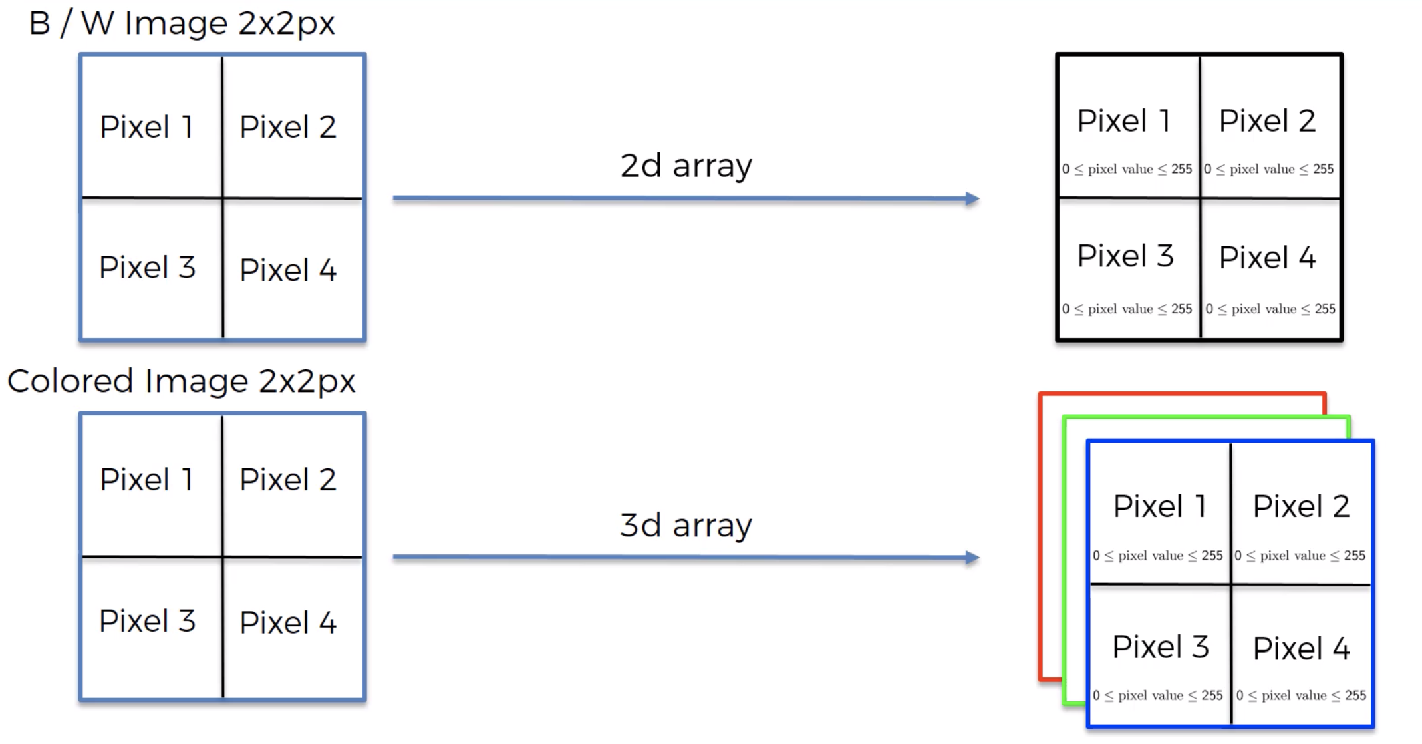

Slide 11
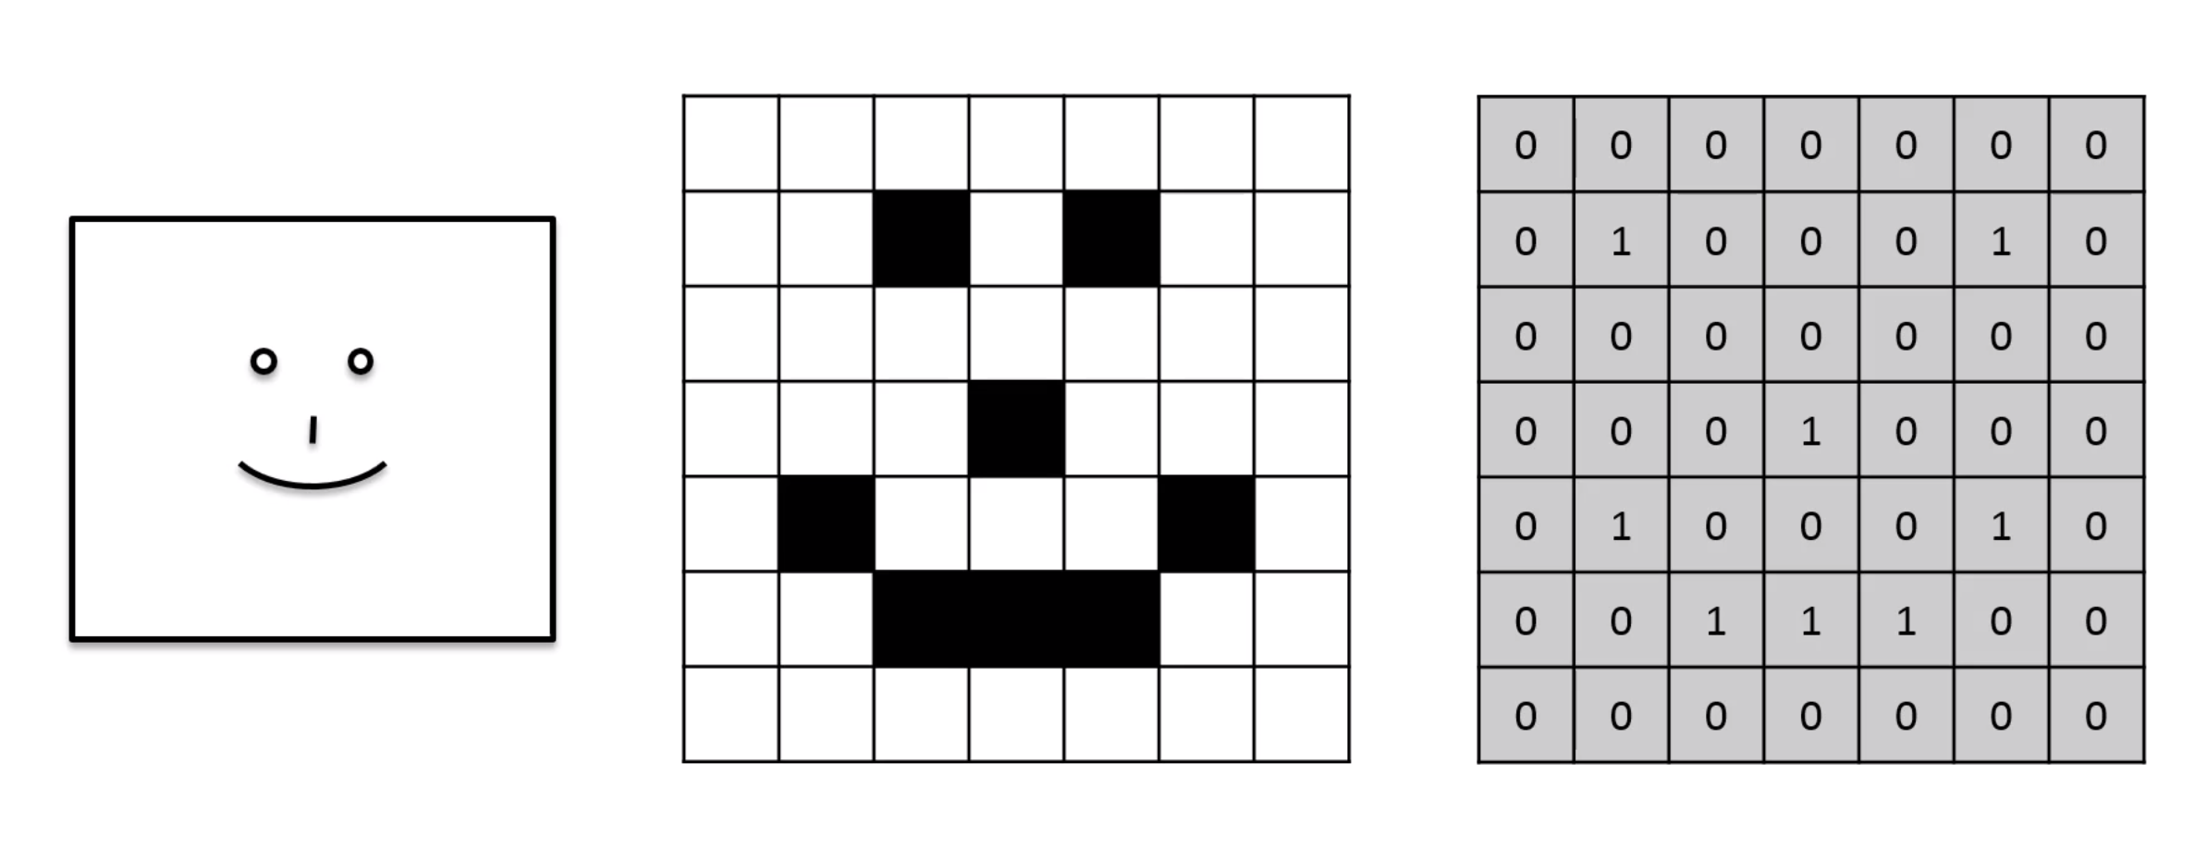


Slide 12
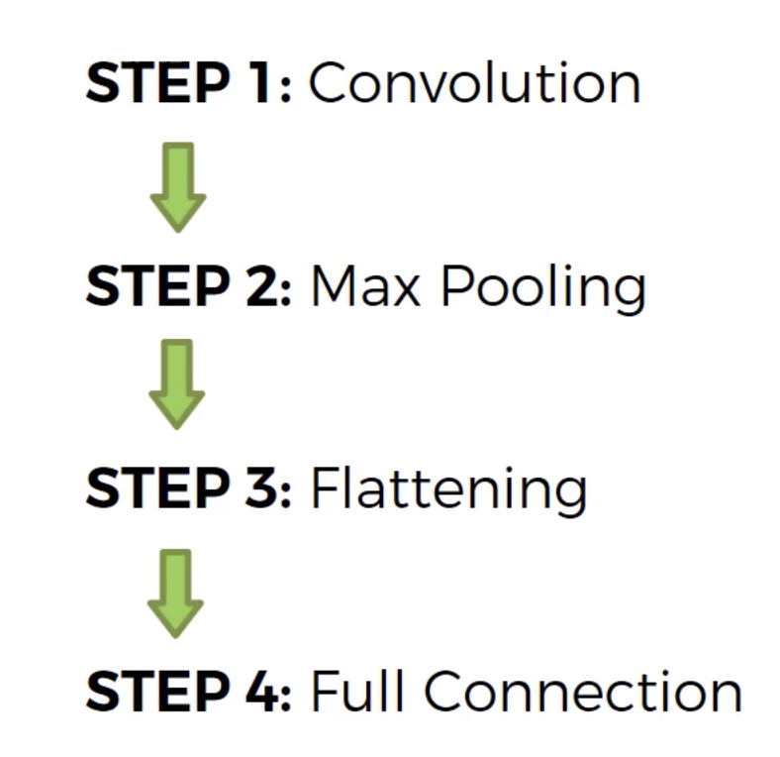

Slide 13
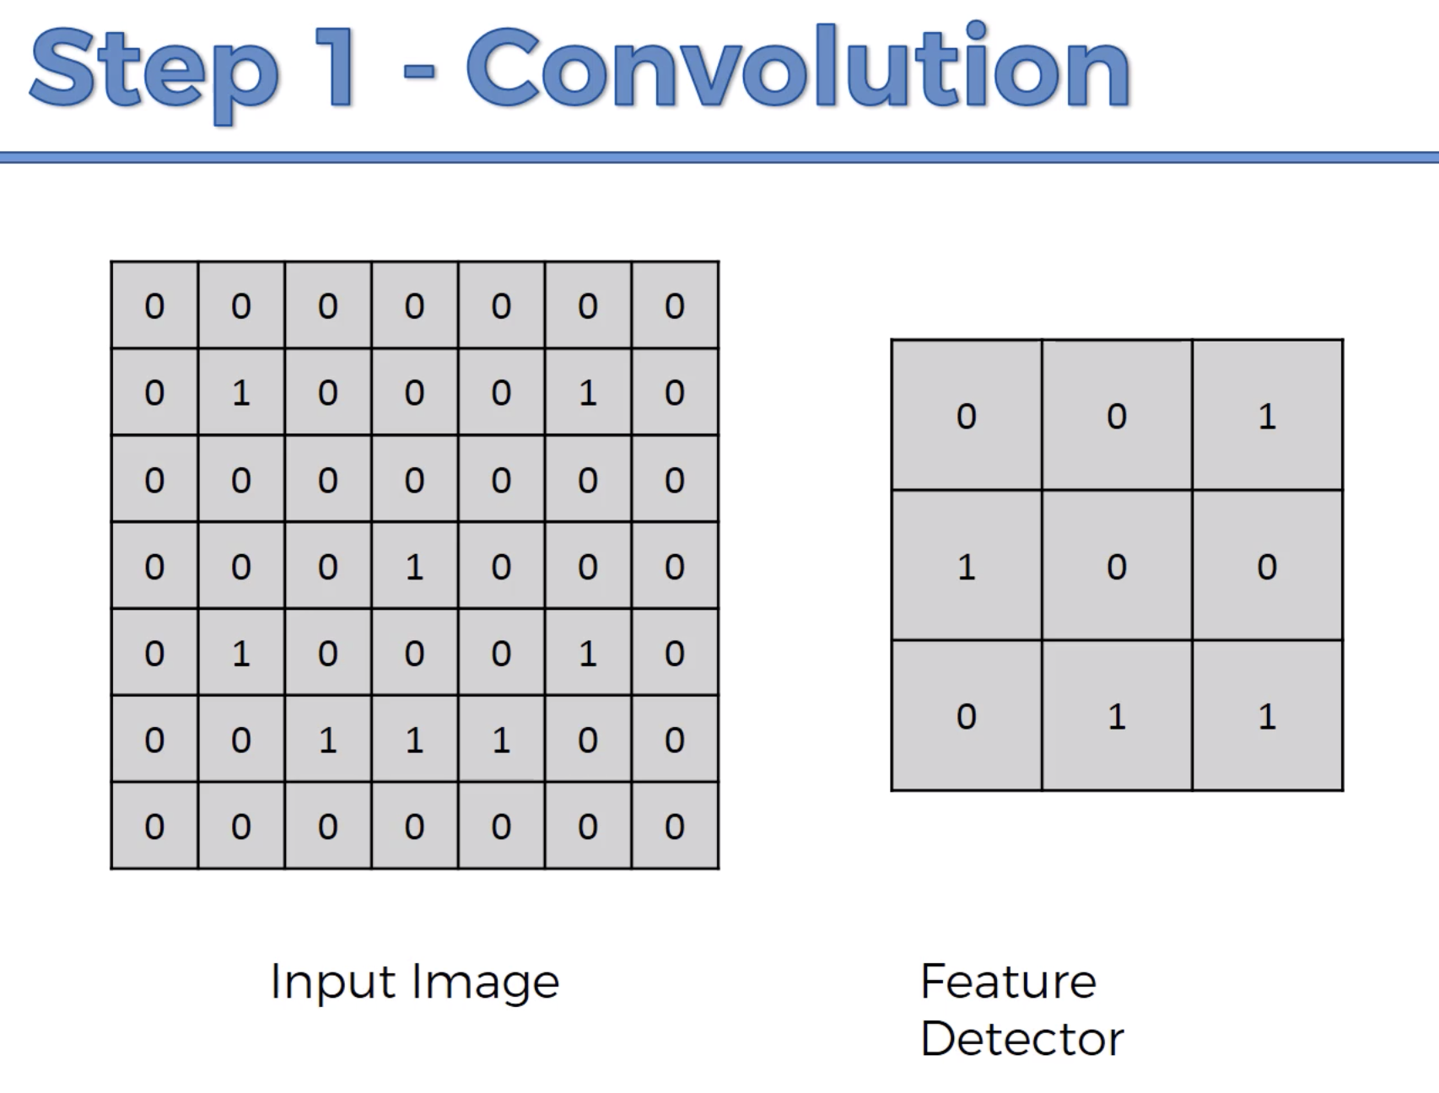

Slide 14
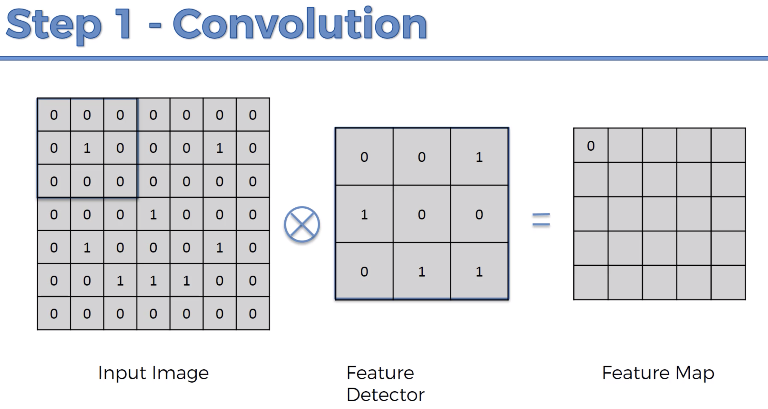

Slide 15
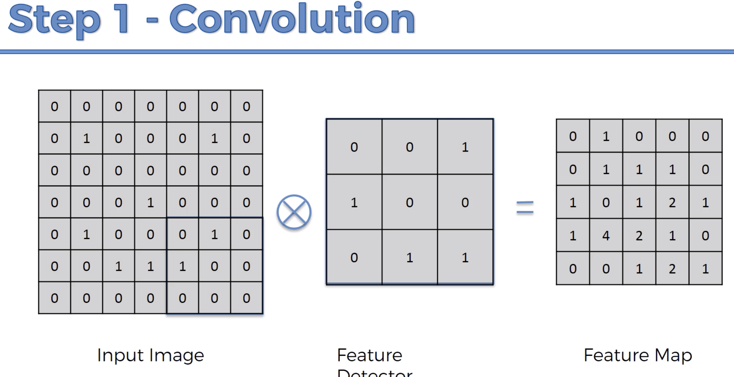

Slide 16
Output Feature map size=
[H-F+2(P)/S]+1
H- Height
F-Filter
P-Padding
S- Stride

Slide 17
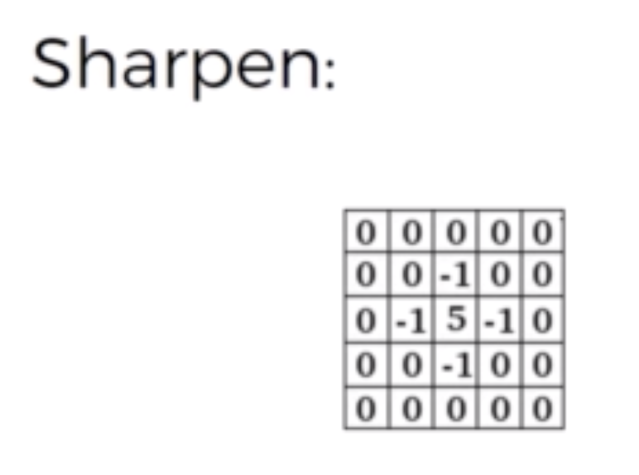
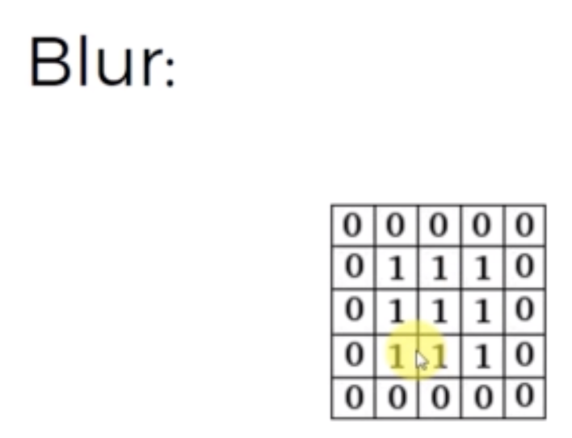
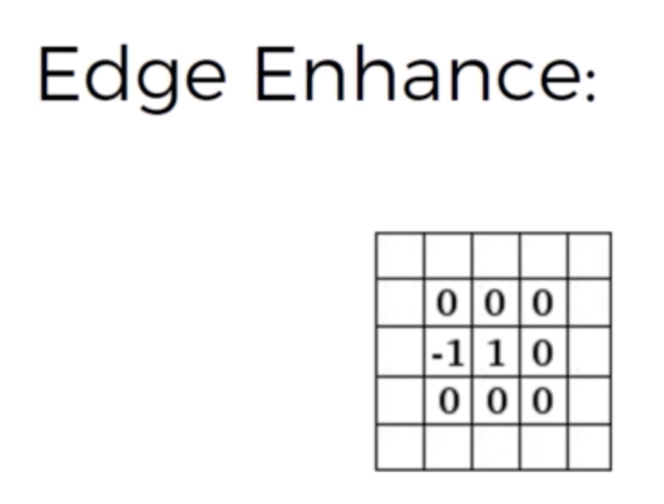
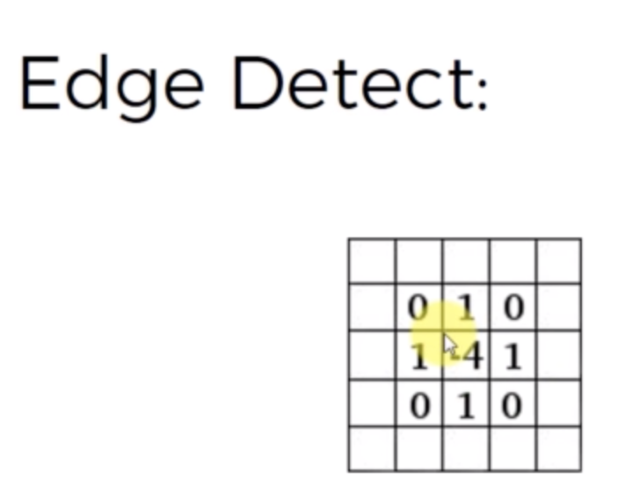
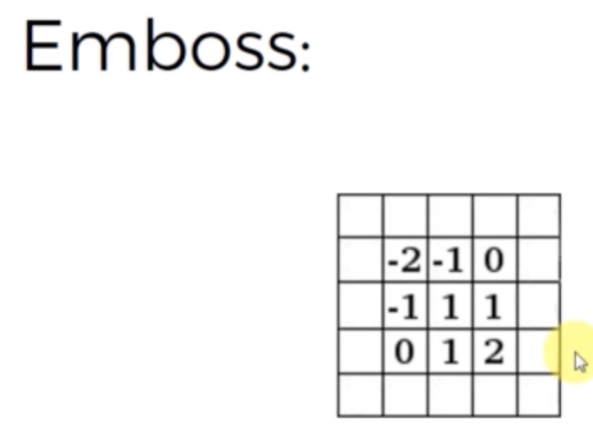

Slide 18
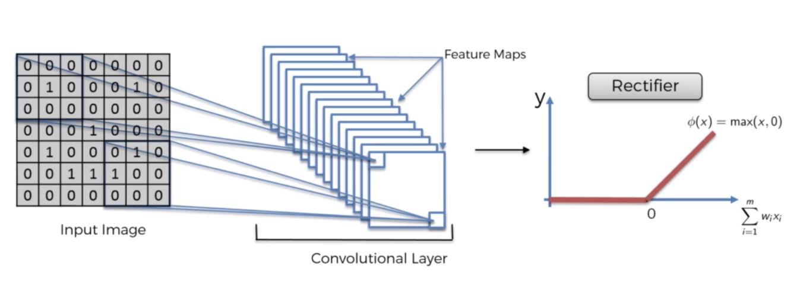

Slide 19
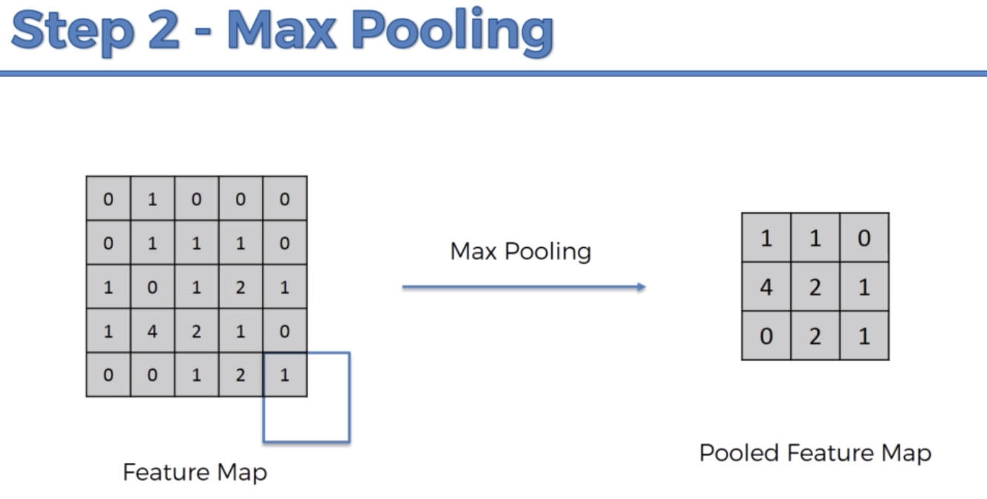

Slide 20
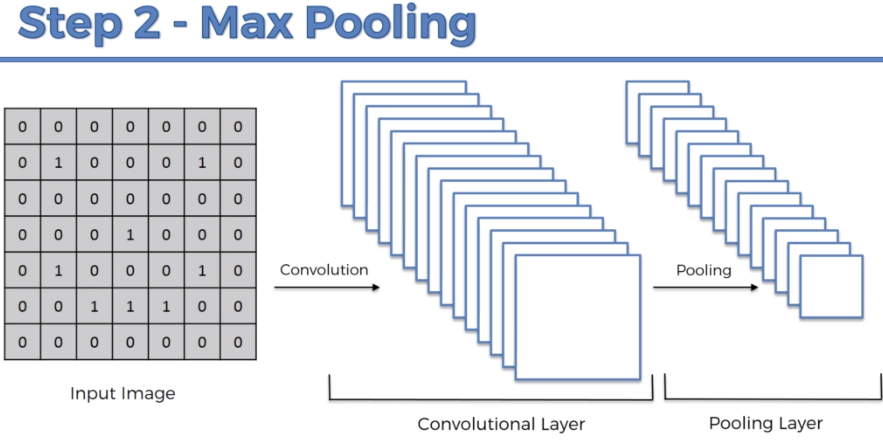

Slide 21
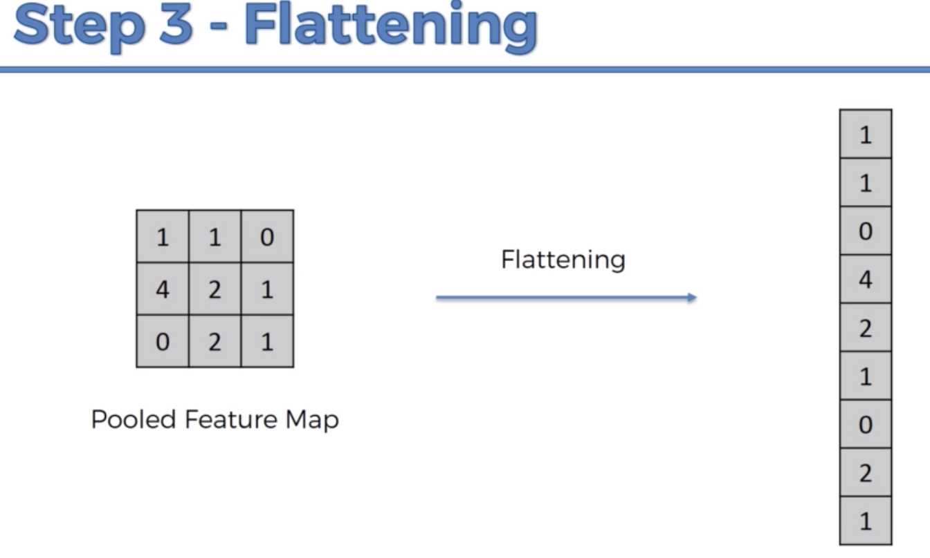

Slide 22
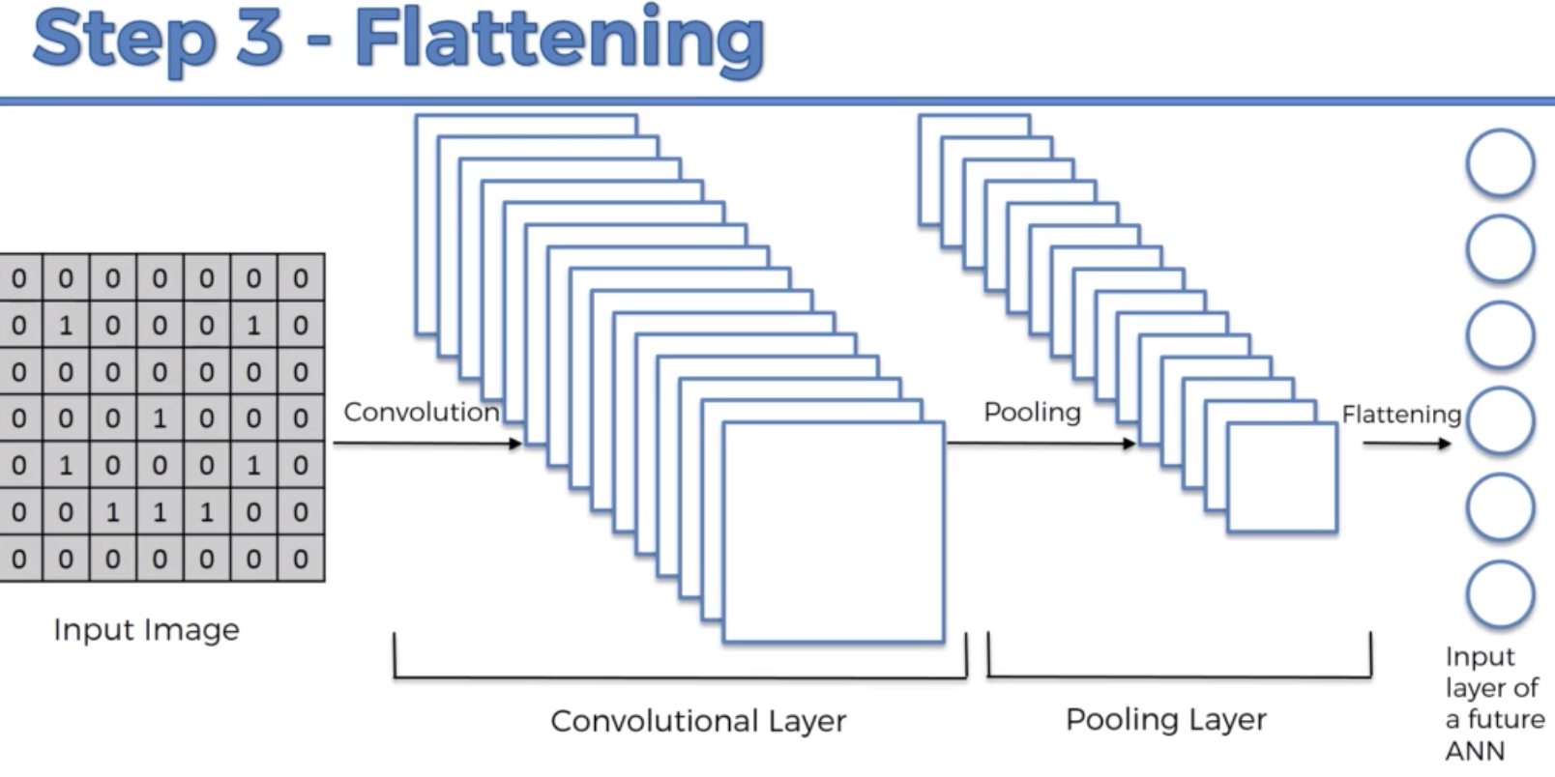

Slide 23
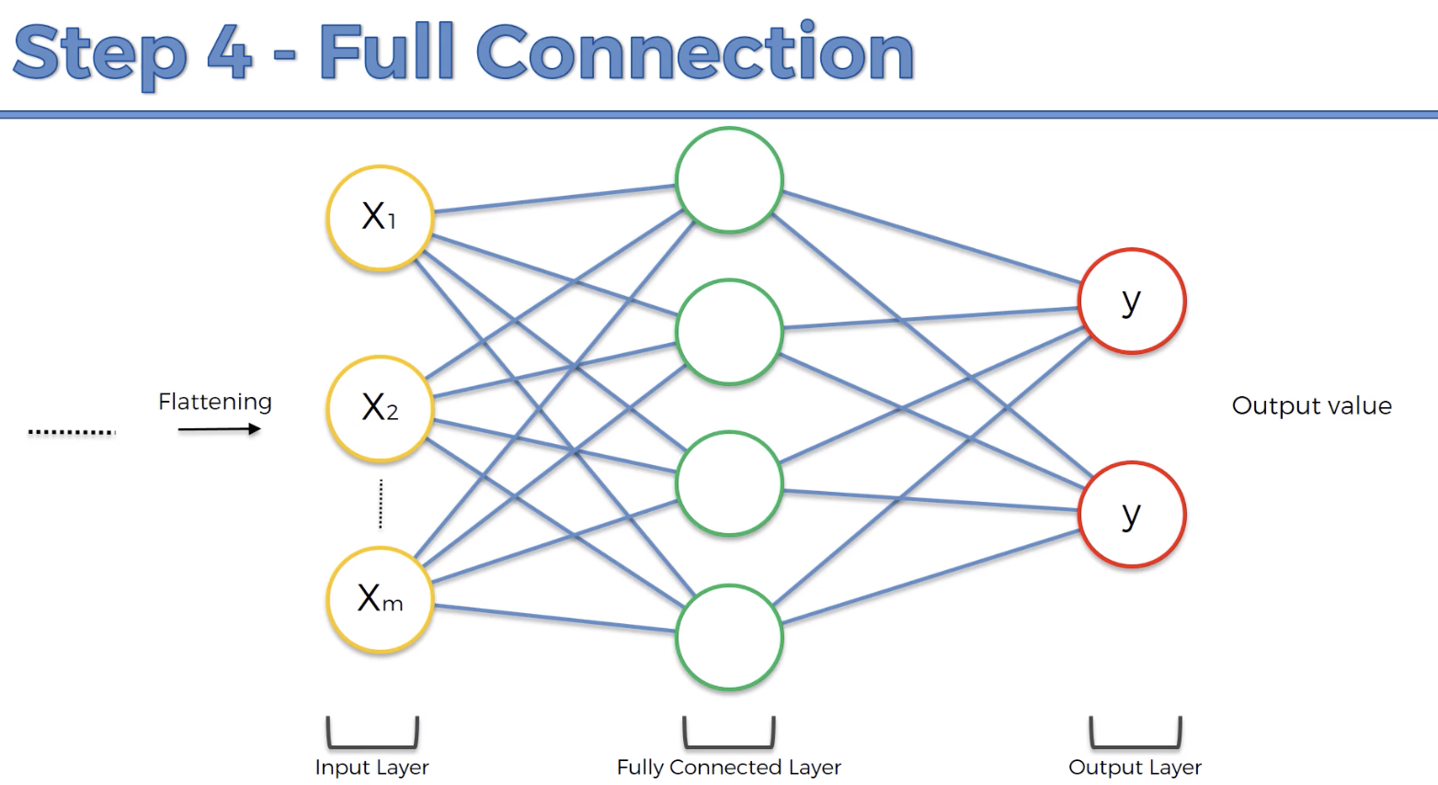

Slide 24
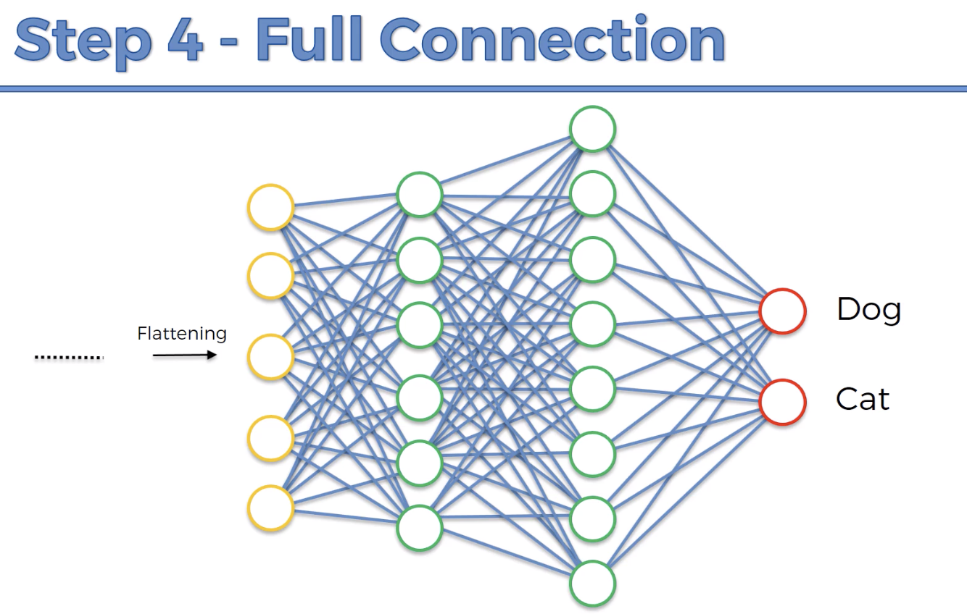

Slide 25
Demo

Slide 26
Parameters in the second CONV1 layer is:
(
(shape of width of filter*shape of height filter*number of filters in the previous layer+1(bias))
*number of filters
)

Slide 27
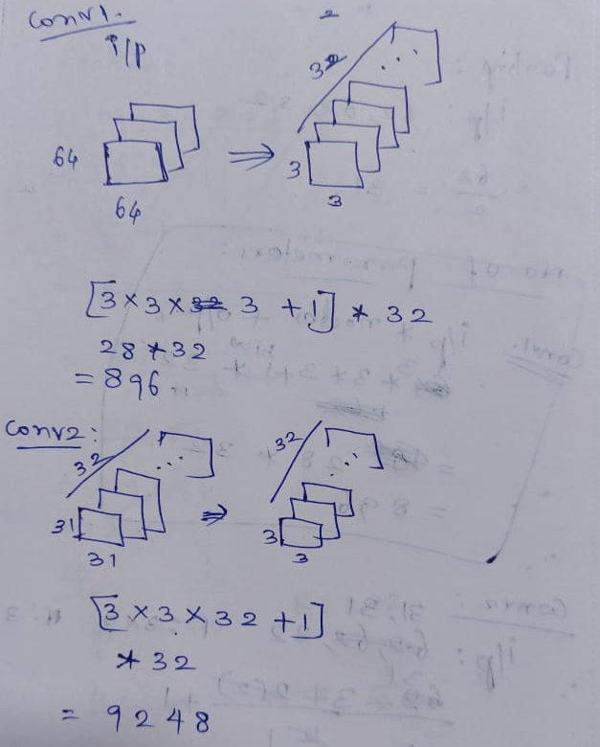

Slide 28
Conv1 : number of parameters
(
(shape of width of filter*shape of height filter*number of filters in the previous layer+1)
*number of filters
)
[3*3*3+1]*32
=896

Slide 29
Output Feature map size=
[H-F+2(P)/S]+1
H- Height
F-Filter
P-Padding
S- Stride
=[[64-3]/1]+1
=(62, 62), 32

Slide 30
Max Pooling
=62 (input)/2 (pool size)
=31

Slide 31
Conv2 : number of parameters
(
(shape of width of filter*shape of height filter*number of filters in the previous layer+1)
*number of filters
)
[3*3*32+1]*32
=9248

Slide 32
Output Feature map size=
[H-F+2(P)/S]+1
H- Height
F-Filter
P-Padding
S- Stride
=[[31-3]/1]+1
=(29, 29), 32

Slide 33
Max Pooling
=29 (input)/2 (pool size)
=14

Slide 34
Flattening
= 14 * 14 * 32
=6272

Slide 35
Dense layer (for 128 neurons)
=6272 * 128 + 128
= 802944

